Slide 1



SafeRoutes
Aişe Özaytürk - 38097
Sarin İç - 38361
Mustafa Enes Özdel - 38049
Kadir Burak Tandoğan - 38354

Slide 2






Pillar 1
Context & Target User
Problem: Safety concerns in big cities
Target User Group: Especially women who frequently walk alone in urban environments.
Perceived safety rather than crime statistics.
Core user expectation: Not only the shortest but a route that feels emotionally safe, understandable, and trustworthy.
Making safety information visible, interpretable, and emotionally supportive rather than alarming.

Slide 3









Pillar 2
Theory and Design Principles
Hick’s Law
Fitts’ Law
Limitting the number of route options to three, reducing decision overload
Designing large, easily reachable touch targets to support accurate interaction
Norman’s Gulf of Evaluation
Shneiderman’s 8 Golden Rules of Interface Design
Ensuring transparency by displaying safety factors: lighting, crowdness etc. to help users correctly interpret the system's output and trust the recommendations
1st Rule: Color consistency: Green for safety and red for danger
7th Rule: Keep users in control by explaining the details and making them decide

Slide 4



Pillar 3
User Demo
SafeRoutes prototype implemented in Figma.
The user selects a start and destination, chooses between three route types, and can report issues during the route.
After completing the route, the user is asked how they felt and can leave a short comment.
This flow was designed to be simple, predictable, and supportive, allowing users to focus on their decision rather than on how to use the interface.

Slide 5
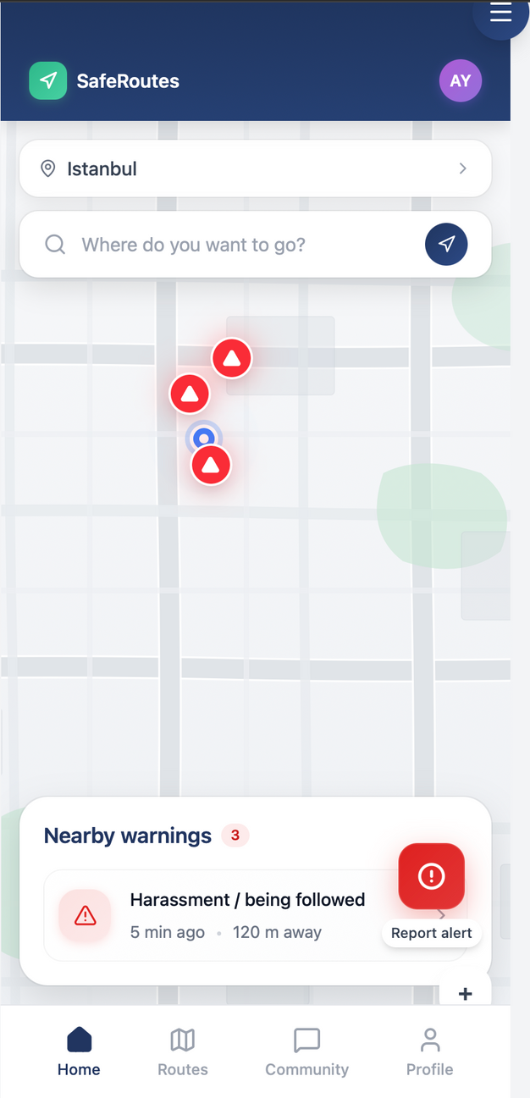
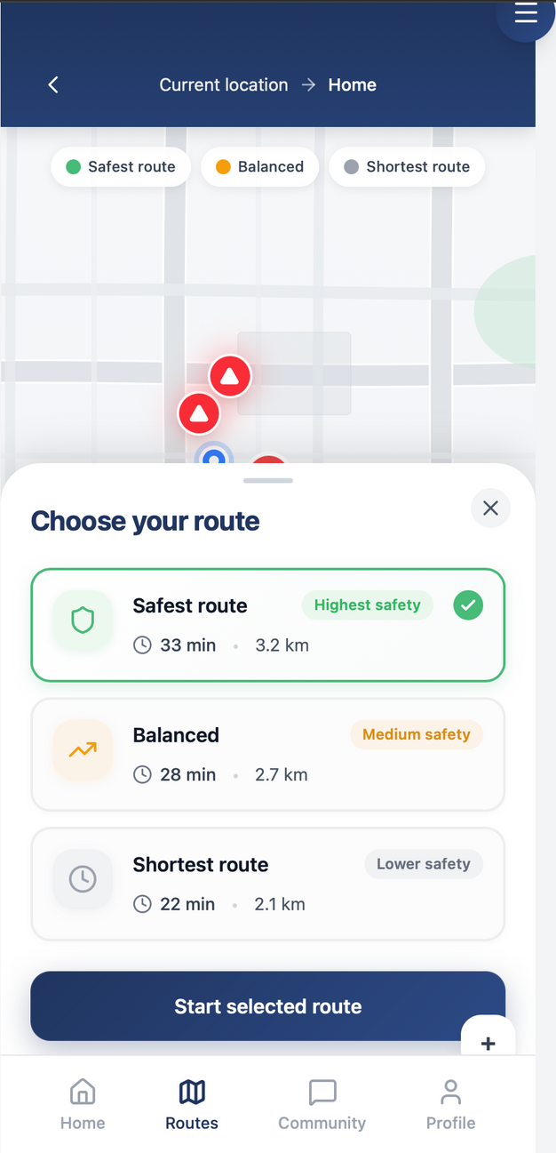
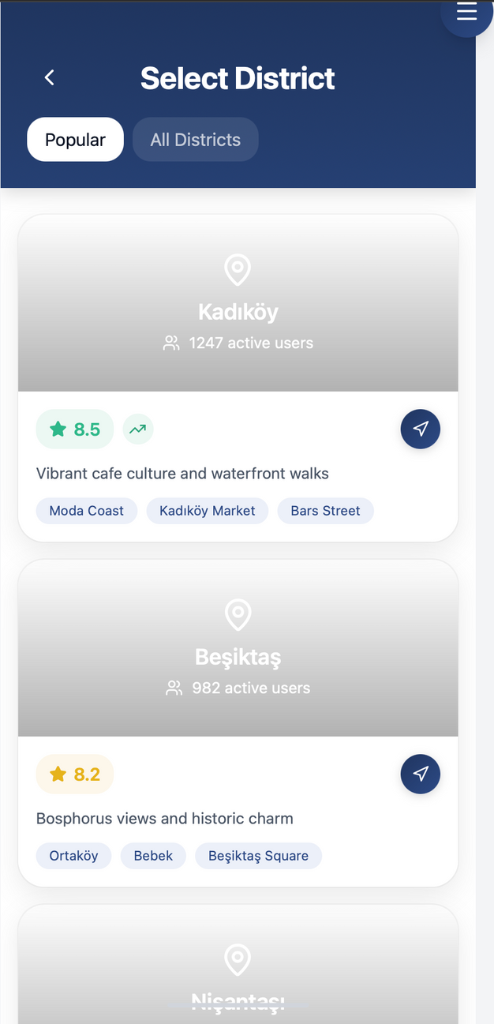

Slide 6
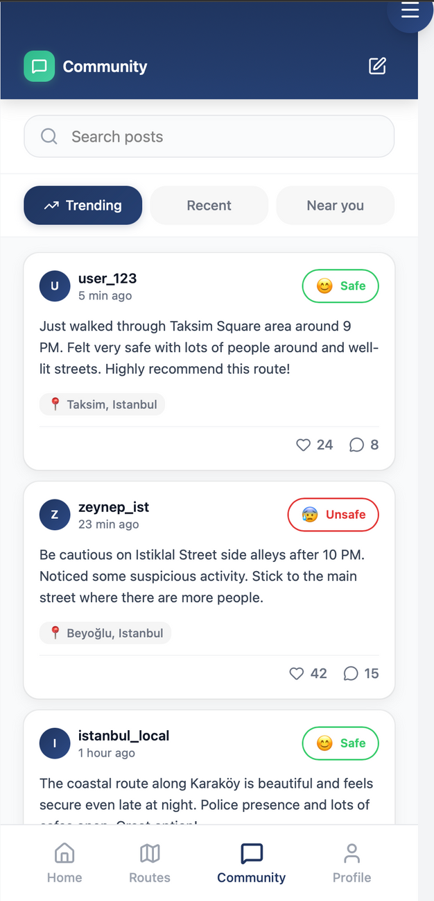
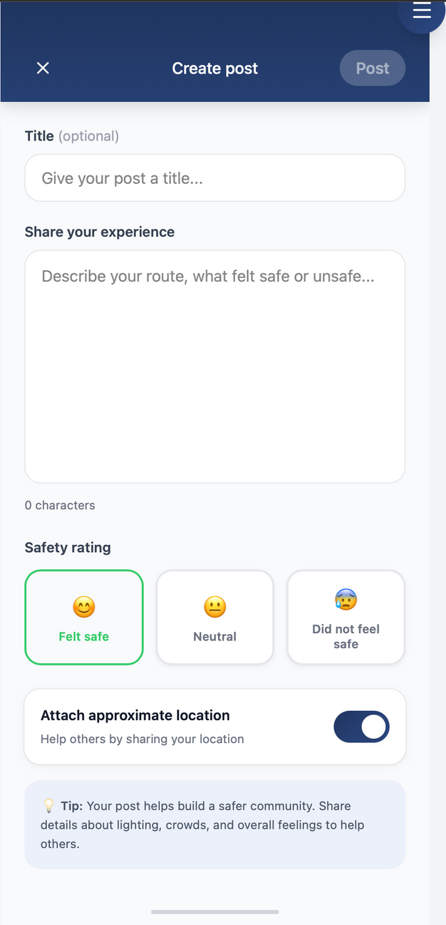
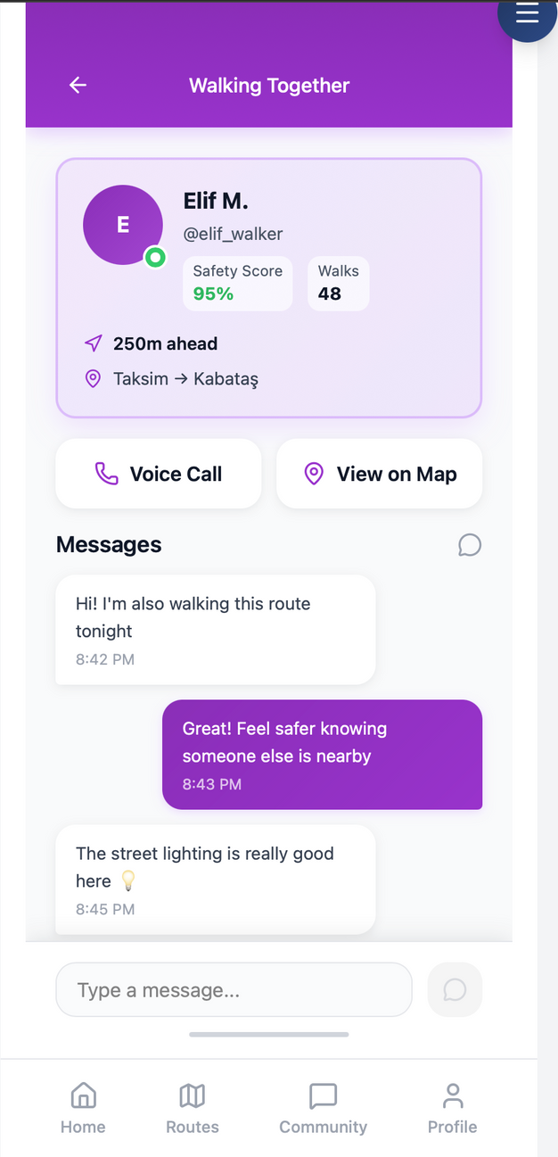

Slide 7
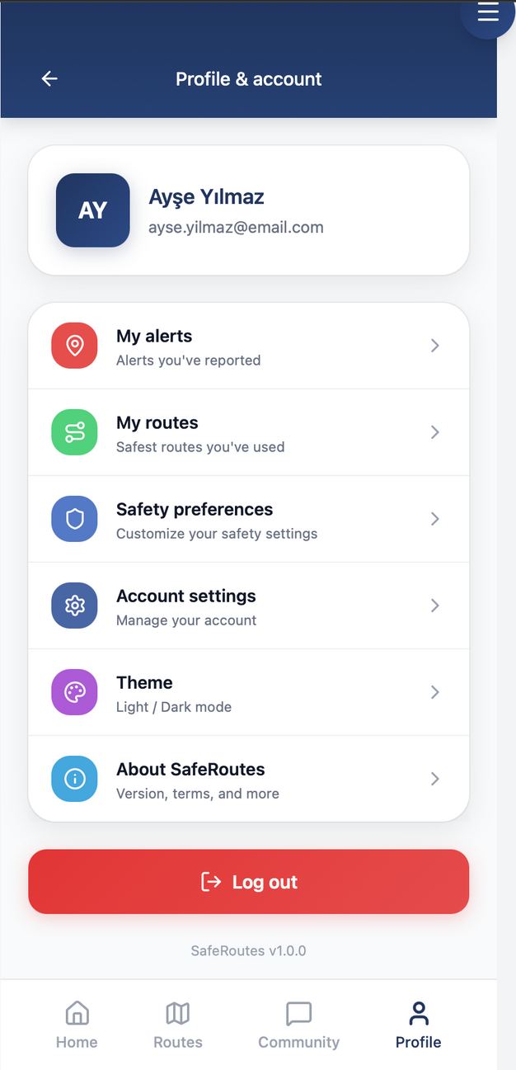
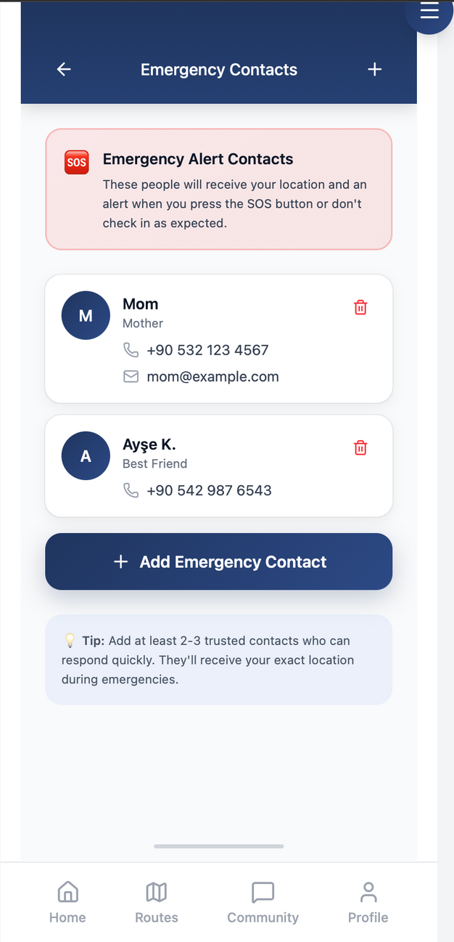
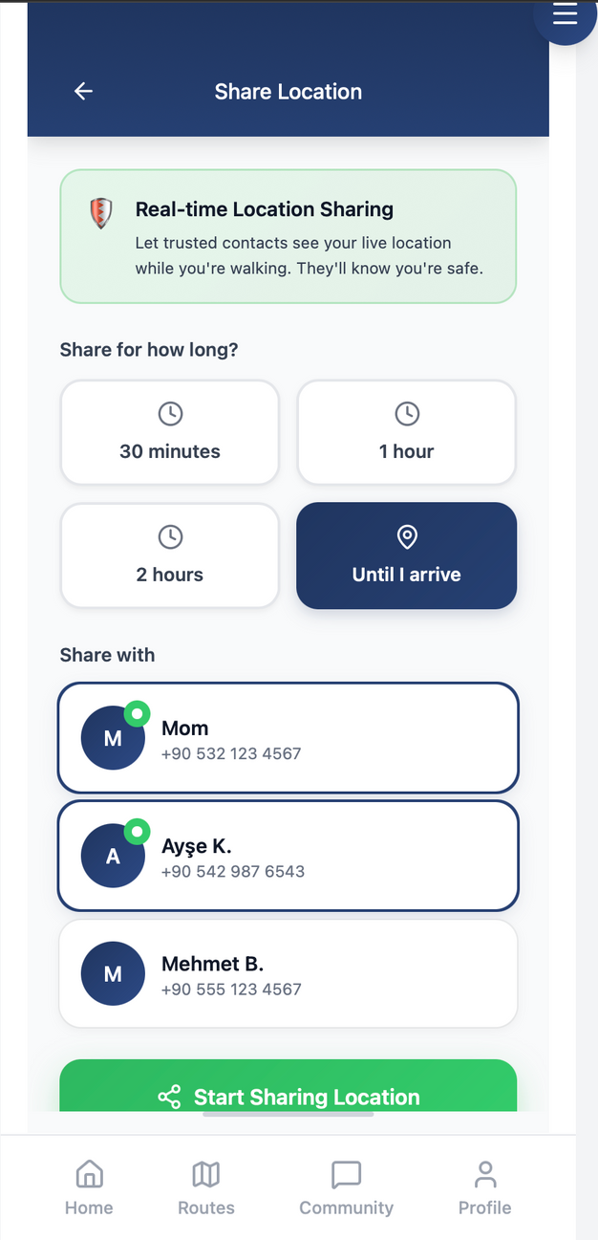

Slide 8
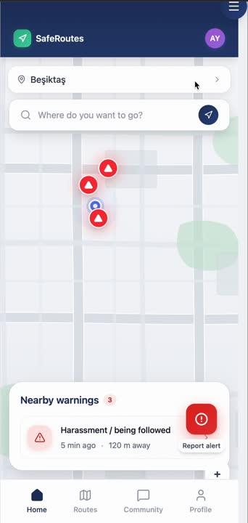
Pillar 3

Slide 9


Pillar 4
Evaluation: User Testing
Observational User Study : In-Progress
Participants: Target N ≈ 25, diverse in age and tech usabilitiy
Procedure: Participants complete a realistic route selection task and then fill out a structured questionnaire.
Measures: Perceived safety, usability, trust, explainability, and decision confidence.
Analysis:
Descriptive statistics to summarize experience,
Inferential tests to compare subgroups

Slide 10

Designing Safety without Ambiguity

Slide 11
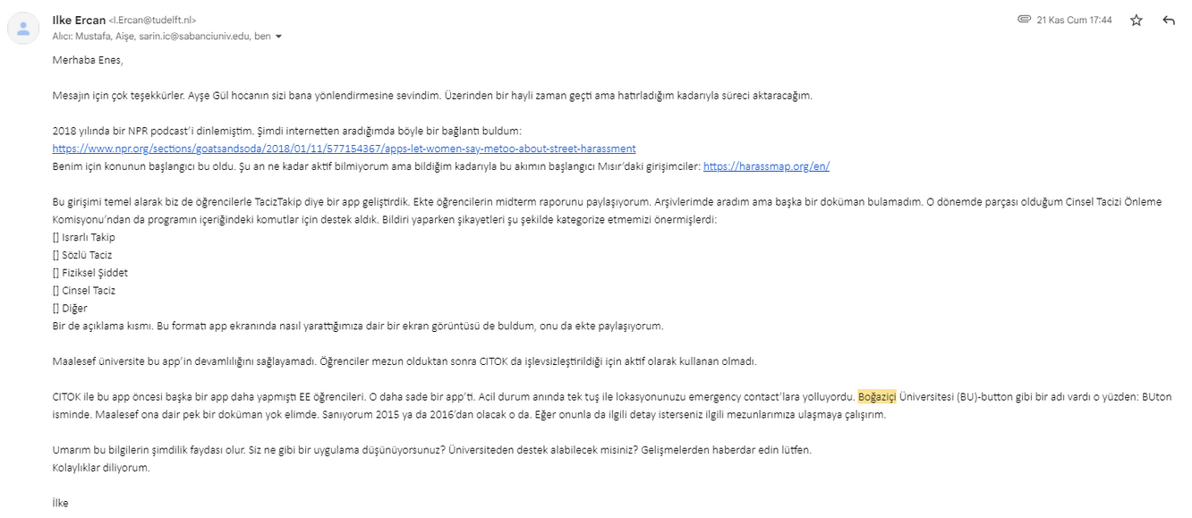
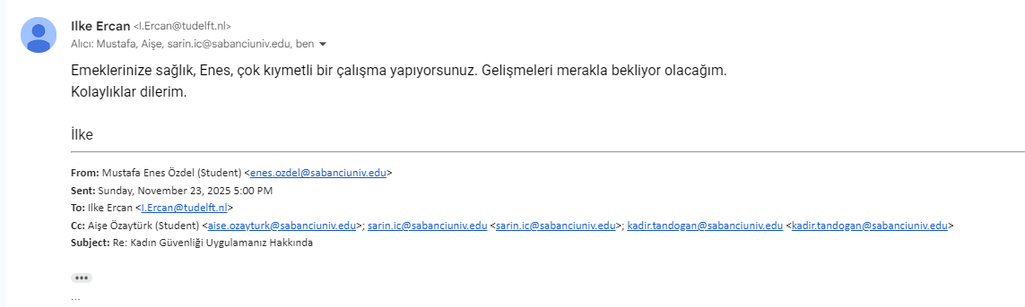

Slide 12
Thank You

